Slide 1
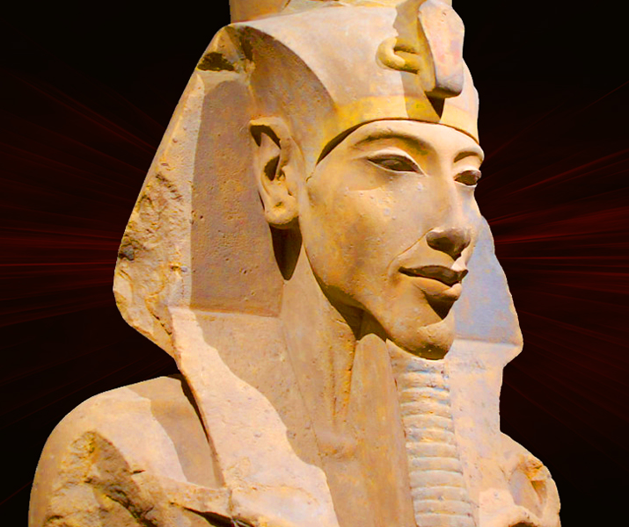
Task FIVE: Explanation (ESSAY)
GOAL/S: Review key P/E/I - historical context
Week 10, Lesson 4

Slide 2
REVIEW – Where are we up to?
Term/Week | Topic/Content | Assessments
T2 – 8 - 9 | Eyptian Society Overview
T2 – 10 - 11 | Years 1 – 4: Amenhotep IV | Week 11 – Essay (15%)
TERM BREAK (Holidays)
T3 – 1 - 2 | Years 5 – 8 | Week 5 – Source Analysis (15%)
T3 – 3 - 5 | Years 9 – 11
T3 – 6 - 8 | Years 12 - 17 | Week 6 – 8 – Inquiry (10%)
T3 – 9 – 10 | Death of Akhenaten and rule of Tutankhamun | Week 10 – Test (15%)

Slide 3
Task FIVE
Explanation (ESSAY) – Task booklet

Slide 4
ESSAY OPTIONS:
Question 1: Analyse the transition of power from Amenhotep III to Amenhotep IV. | Question 2: Investigate the significance of Amenhotep IV's religious reforms, particularly the introduction of Re-Horakte as the central deity. | Question 3: Assess the immediate changes under Amenhotep IV's reign.

Slide 5
Class Discussion
What do you already know about essay writing structures?

Slide 6
Essay Structure
An essay is a piece of writing that presents an argument or discusses a particular topic in a structured format. Its purpose is to inform, persuade, or entertain the reader while conveying the author's perspective or analysis on the subject matter.
Introduction: This section provides background information on the topic and presents the thesis statement, which outlines the main argument or purpose of the essay.
Body Paragraphs: These paragraphs develop and support the thesis statement by presenting evidence, examples, and analysis. Each body paragraph focuses on a specific aspect or sub-argument related to the main topic.
Conclusion: The conclusion summarizes the main points of the essay and restates the thesis statement in light of the evidence presented in the body paragraphs. It may also offer insights or suggestions for further consideration.
Notes:
Who is the author?

Slide 7
Introduction
Function: Introduces the topic to the reader and provides context for the argument. It also grabs the reader's attention and sets the tone for the essay.
It must include the following:
Thesis Statement – What is the essay arguing? (NOT WHAT IS IT ABOUT)
Background information – A brief overview of key people, events, ideas
Essay Map – A brief overview of what each body paragraph will discuss

Slide 8
Body Paragraphs
Function: Each body paragraph presents a separate argument or piece of evidence to support the thesis statement. They provide depth and detail to the essay's main argument.
It must include the following:
Topic Sentence– What is the paragraph arguing? (NOT WHAT IS IT ABOUT)
Explanation/Evidence– An overview of key people, events, ideas related to topic sentence, and examples/evidence that support your claims
Link– Summary sentence

Slide 9
Topic Sentence Vs. Thesis Statements
Thesis Statement (Introduction Paragraph):
Purpose: The thesis statement serves as the main argument or central claim of the entire essay. It provides a clear and concise overview of the essay's purpose and the stance the author will take on the topic.
Placement: Typically found at the end of the introduction paragraph, though it can sometimes be positioned elsewhere depending on the essay's structure.
Scope: The thesis statement encapsulates the entirety of the essay, outlining what the reader can expect to find in the subsequent body paragraphs.
Example: "In this essay, I will argue that Tiberius and Gaius Gracchus significantly shaped the period of 133–121 BCE in ancient Rome through their political reforms and advocacy for social justice, fundamentally altering the socio-political landscape of the Roman Republic."
Topic Sentence (Body Paragraph):
Purpose: The topic sentence serves as a mini-thesis for the individual paragraph, outlining the main point or argument that will be discussed in that specific paragraph.
Placement: Typically found at the beginning of each body paragraph to provide a clear focus and direction for the reader.
Scope: The topic sentence sets the tone and direction for the paragraph, guiding the reader through the specific argument or evidence that will be presented.
Example: "One of the key contributions of Tiberius Gracchus to the socio-political landscape of ancient Rome was his initiation of land reforms aimed at addressing the unequal distribution of land among the populace."
Notes:
In summary, while the thesis statement outlines the overarching argument of the entire essay, the topic sentence focuses on a specific point or argument within a single paragraph, guiding the reader through the essay's structure and content.

Slide 10
Conclusion
Function: Summarizes the main points of the essay and reinforces the significance of the argument presented in the thesis statement.
SAMPLE A: In conclusion, Tiberius and Gaius Gracchus did some stuff during the period of 133–121 BCE. They tried to help poor people and change things, but it didn't really work out. Overall, they did some things, but it's hard to say if they really made a big difference in ancient Rome.
SAMPLE B: the legacy of Tiberius and Gaius Gracchus reverberates throughout the history of Ancient Rome, casting a long shadow over the socio-political landscape of the tumultuous period of 133–121 BCE. Through their bold reforms and unwavering advocacy for the rights of the plebeian class, the Gracchi brothers challenged the entrenched power structures of the Roman Republic, laying bare the stark inequalities that plagued society. While their efforts ultimately met with resistance and tragedy, their courageous actions paved the way for future reform movements and ignited a spark of social consciousness that would endure for centuries to come. Indeed, the enduring impact of the Gracchi brothers serves as a poignant reminder of the enduring struggle for justice and equality in the pages of history.

Slide 11
ACTIVITY
ESSAY NOTES PAGE

